Slide 1


Slide 2





Beat Browser
PROG24178
Amir Hosein Khanmohammadi
Notes:
Welcome to the Music Catalog System presentation! Our goal today is to provide you with a comprehensive understanding of this powerful application and how it can help you manage your music collection with ease. Throughout this presentation, we will cover the following topics:
By the end of this presentation, you will have a thorough understanding of how the Music Catalog System works and how it can benefit you in organizing and managing your music library.

Slide 3


Our Activity :
Introduction to the Music Catalog System
Features and functionalities of the application
Benefits of using the Music Catalog System
How to get started with the Music Catalog System
Tips and tricks for optimizing your music collection management
UML of the Music Catalog System
Notes:
Welcome to the Music Catalog System presentation! Our goal today is to provide you with a comprehensive understanding of this powerful application and how it can help you manage your music collection with ease. Throughout this presentation, we will cover the following topics:
By the end of this presentation, you will have a thorough understanding of how the Music Catalog System works and how it can benefit you in organizing and managing your music library.

Slide 4

About
Beat Browser
The Music Catalog System is an exceptional application that provides music enthusiasts with an efficient and professional way to manage their music collections. With this application, you can easily organize and categorize your music library.
The Music Catalog System is designed with a user-friendly interface, making it easy to navigate and use. The application allows you to easily search for and access your music, making it a convenient tool for both casual music lovers and serious collectors.

Slide 5
Features & functionalities
Beat Browser
Users can easily edit song details, such as title, artist, album, release date, genre, length, writer(s), producer(s), and awards and nominations, directly within the Music Catalog System. This makes it easy to keep track of important information about each song, and update it as needed.
One of the key features of the application is the ability to display the list of songs by category. This makes it easy for users to browse their music collections and locate specific tracks. The application also allows users to search for songs by title, artist, and genre, further enhancing the ability to find and manage music efficiently.
The Music Catalog System also enables users to delete songs from their collections as well as add new songs to them. Users can add their own custom genres to the predefined list of categories, allowing for even greater flexibility in organizing music collections.
By default, the system stored and tracks detailed information of 40 songs across ten categories and Users can also add their own custom genres as needed. The categories are: Pop, Europop, Disco, Rock, Jazz, Hip-Hop, Rap, Electronic, Country, and K-Pop
Each Song Including: title, artist, album, release date, genre, length, writer(s), producer(s), and awards and nominations.

Slide 6
Detailed information
of each song which program shows
Field | Description | Data Type
Title | The name of the song | String
Artist | The name of the performer or band | String
Album | The album on which the song appears | String
Release date | The date the song was officially released | Date
Genre | The musical style of the song | String
Length | The duration of the song in minutes and seconds | String
Writer(s) | The person or people who wrote the lyrics and/or music for the song | String
Producer(s) | The person or people who produced the recording of the song | String
Awards/Nominations | Any awards or nominations the song has received, such as Grammy Awards or Academy Awards | String
ID | Every song got a unique ID whenever added to the database. | Int

Slide 7

Benefits of using the Music Catalog System
The Music Catalog System provides a wealth of benefits for music enthusiasts who want to manage their music collections with ease and efficiency.
Organization
Customization
Efficiency
Accuracy
Accessibility
Professionalism
Notes:
Organization: The Music Catalog System makes it easy to organize your music collection, allowing you to sort songs by category and genre. This makes it easier to find specific tracks and create personalized playlists.
Customization: With the ability to add custom genres to the predefined list, users can create a highly customized music collection that caters to their unique tastes.
Efficiency: The Music Catalog System enables users to manage their music collections with ease, reducing the time and effort required to locate, edit, and add new songs.
Accuracy: With the ability to track detailed information about each song, users can ensure that their music collection is accurate and up-to-date.
Accessibility: The Music Catalog System allows users to access their music collection from any device, providing a convenient way to enjoy their music no matter where they are.
Professionalism: With its thoughtfully designed interface and powerful features, the Music Catalog System provides a professional and polished way to manage music collections.

Slide 8

How to get started with the Music Catalog System
Download the Music Catalog System zip file to your computer.
Extract the contents of the zip file to a location of your choice.
Navigate to the folder where the Music Catalog System files are located.
Open an IDE (like Visual Studio Code).
Locate the MainUI.java file in the Music Catalog System folder.
Open the MainUI.java file in your IDE.
Run the MainUI.java file in your IDE to launch the Music Catalog System application.

Slide 9
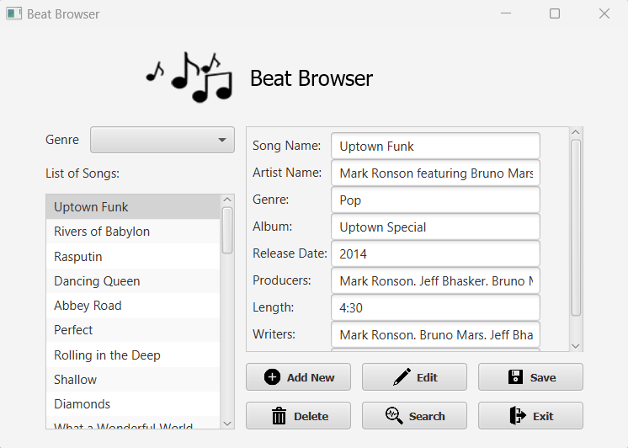
Beat Browser
Main Page
Features of
displays the list of songs by category
browse
search
edit
delete
songs from their collection.
The system also allows users to add new songs to their collection with minimal effort.

Slide 10

public void displaySongDetails() {
// display the details of the current song
String selectedSong = songNames.getSelectionModel().getSelectedItem();
SongList songsByTitle = songList.findSongsByTitle(selectedSong);
if (songsByTitle.size() > 0) {
Song song = songsByTitle.get(0);
songName.setText(song.getSongTitle());
artistName.setText(song.getSongArtist());
albumName.setText(song.getSongAlbum());
String[] dateComponents = song.getSongReleaseDate().toString().split(" ");
String dateYear = dateComponents[dateComponents.length - 1];
releaseDate.setText(dateYear);
genreName.setText(song.getSongGenre());
writers.setText(song.getSongWriters());
producers.setText(song.getSongProducers());
awards.setText(song.getSongAwards());
songLength.setText(song.getSongLength());
}
}
Display Song Details
Notes:
This is a Java method called displaySongDetails that displays the details of the currently selected song in the songNames ListView.
The method first gets the title of the currently selected song from the songNames ListView using the getSelectionModel() method. It then uses a method called findSongsByTitle on the songList object to retrieve all songs in songList that match the selected song title.
If at least one song is returned, the method proceeds to populate a number of JavaFX Label objects with the details of the selected song, such as the song title, artist name, album name, release date, genre, writers, producers, awards, and song length.
To populate the releaseDate label, the method splits the release date string returned by getSongReleaseDate() method into an array of components separated by space and selects the last component as the year. Finally, the method sets the text of each Label object with the corresponding song details.

Slide 11
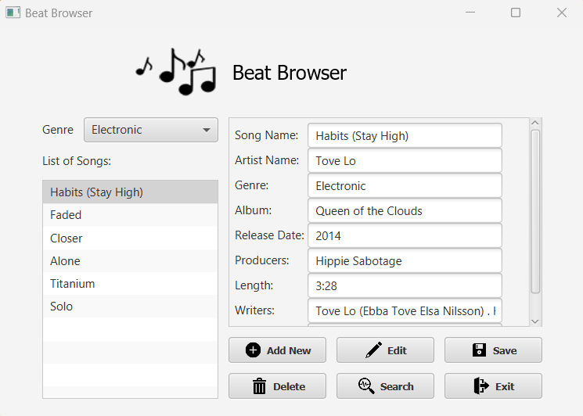
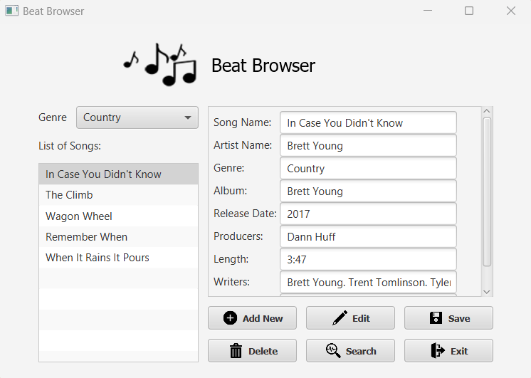
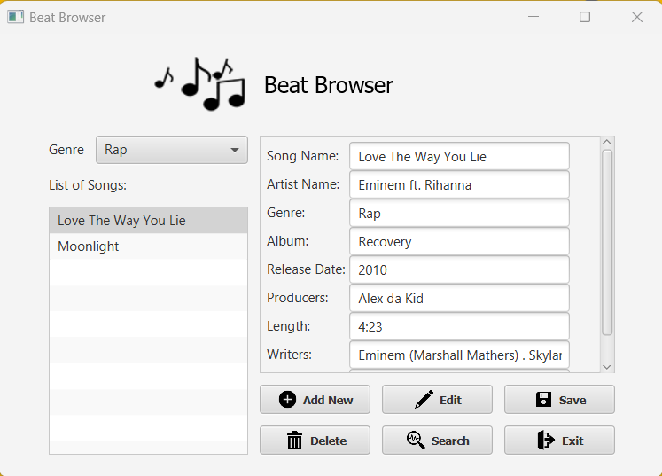
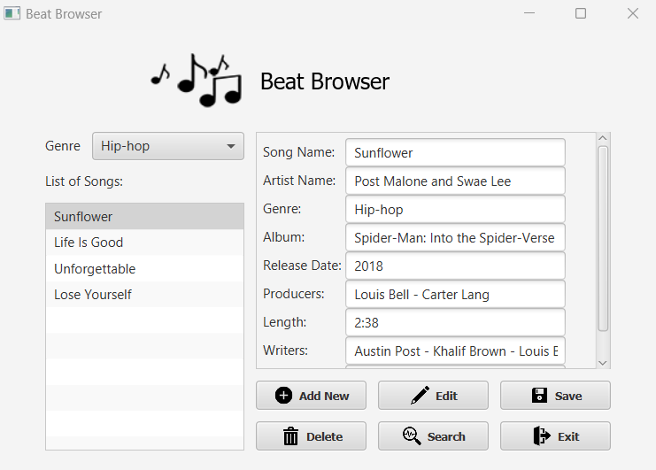

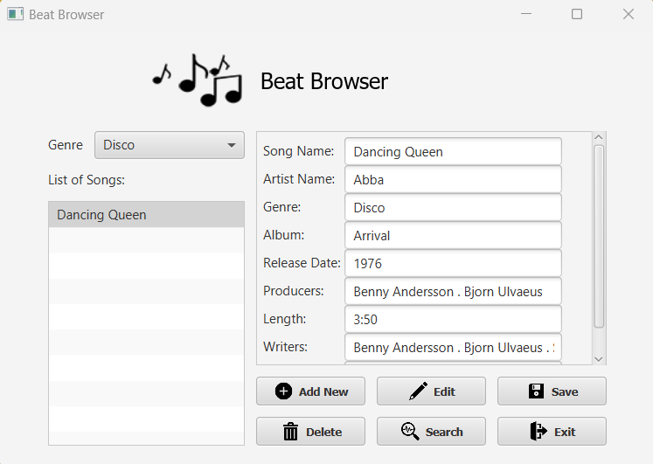
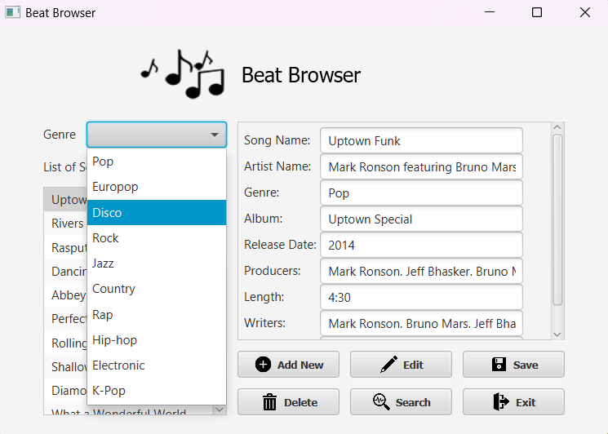
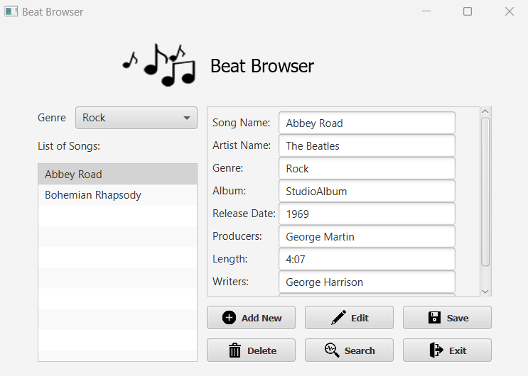
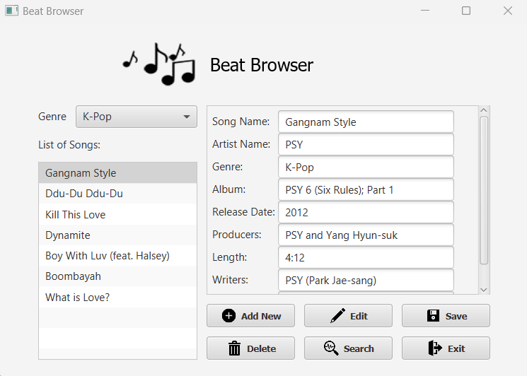
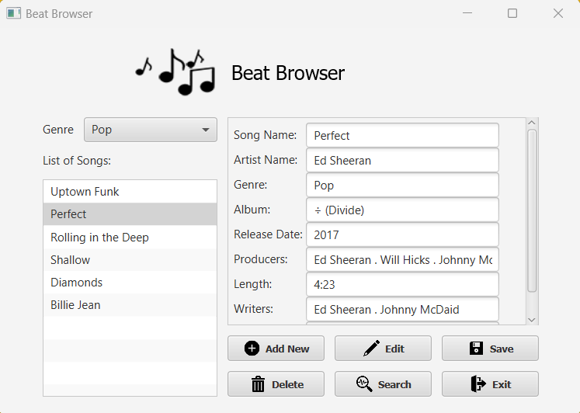
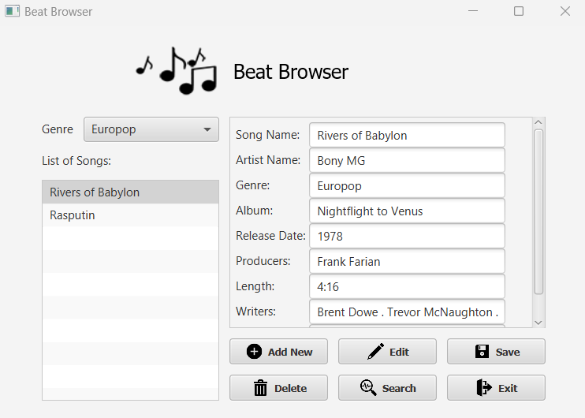


Slide 12


public void displaySongList(boolean initial) {
if (initial) {
for (int i = 0; i < songList.size(); i++) {
songs.add(songList.get(i).getSongTitle());
}
songNames.setItems(songs);
songNames.setPrefWidth(400);
songNames.setPrefHeight(130);
grid.add(songNames, 0, 4, 5, 3);
} else {
String selectedGenre = genreList.getSelectionModel().getSelectedItem().toString();
SongList songsByGenre = songList.findSongsByGenre(selectedGenre);
songs.clear();
for (int i = 0; i < songsByGenre.size(); i++) {
songs.add(songsByGenre.get(i).getSongTitle());
}
}
songNames.getSelectionModel().select(0);
displaySongDetails();
}
Display Song List
Notes:
This is a Java method called displaySongList that takes a boolean parameter called initial.
The method first checks the value of the initial parameter. If initial is true, it populates a JavaFX ListView called songNames with the titles of all songs in a list called songList. It then sets the preferred width and height of the songNames ListView to 400 and 130, respectively, and adds it to a JavaFX GridPane called grid at row 4, column 0, spanning 5 columns and 3 rows.
If initial is false, it gets the selected genre from another JavaFX ComboBox called genreList and uses a method called findSongsByGenre on the songList object to retrieve all songs in songList that belong to the selected genre. It then clears the songs list and populates it with the titles of the songs returned by findSongsByGenre.
Regardless of whether initial is true or false, the method then selects the first item in the songNames ListView using the setSelectionModel() method, and calls another method called displaySongDetails() to display the details of the selected song.

Slide 13
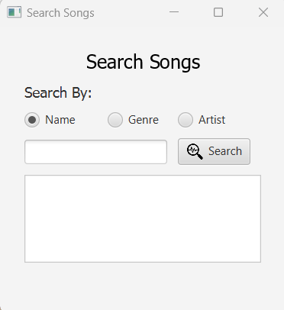
Search Page
Beat Browser
Features of
The search function enables users to find specific songs by title, artist, or category quickly.

Slide 14


Search | find Songs By Title
public SongList findSongsByTitle(String title) {
SongList songsByTitle = new SongList();
for (Song song : songList) {
if ((song.getSongTitle().equalsIgnoreCase(title)) ||
(song.getSongTitle().toLowerCase().contains(title.trim())))
{
songsByTitle.addSong(song);
}
}
return songsByTitle;
}
Notes:
This is a Java method called findSongsByTitle that searches the songList for songs with a specified title, and returns a new SongList object containing all songs that match the search criteria.
The method takes a String parameter called title, which represents the title of the song(s) being searched for. It then creates a new SongList object called songsByTitle to store the songs that match the search criteria.
The method then iterates over each Song object in the songList. For each Song object, it checks if the song title matches the title parameter (ignoring case), or if the song title contains the title parameter (ignoring case and leading/trailing white spaces).
If a match is found, the Song object is added to the songsByTitle list using the addSong method of the SongList class. Finally, the method returns the songsByTitle object, which contains all songs that match the search criteria.

Slide 15
Search | find Songs By Artist
public SongList findSongsByArtist(String artist) {
SongList songsByArtist = new SongList();
for (Song song: songList) {
if ((song.getSongArtist().equalsIgnoreCase(artist)) ||
(song.getSongArtist().toLowerCase().contains(artist.trim()))) {
songsByArtist.addSong(song);
}
}
return songsByArtist;
}
Notes:
This is a Java method called findSongsByArtist that searches the songList for songs with a specified artist, and returns a new SongList object containing all songs that match the search criteria.
The method takes a String parameter called artist, which represents the artist of the song(s) being searched for. It then creates a new SongList object called songsByArtist to store the songs that match the search criteria.
The method then iterates over each Song object in the songList. For each Song object, it checks if the song artist matches the artist parameter (ignoring case), or if the song artist contains the artist parameter (ignoring case and leading/trailing white spaces).
If a match is found, the Song object is added to the songsByArtist list using the addSong method of the SongList class. Finally, the method returns the songsByArtist object, which contains all songs that match the search criteria.

Slide 16
Search | find Songs By Genre
public SongList findSongsByGenre(String genre) {
SongList songsByGenre = new SongList();
for (Song song: songList) {
if ((song.getSongGenre().equalsIgnoreCase(genre)) ||
(song.getSongGenre().toLowerCase().contains(genre.trim()))) {
songsByGenre.addSong(song);
}
}
return songsByGenre;
}
Notes:
This is a Java method called findSongsByGenre that searches the songList for songs with a specified genre, and returns a new SongList object containing all songs that match the search criteria.
The method takes a String parameter called genre, which represents the genre of the song(s) being searched for. It then creates a new SongList object called songsByGenre to store the songs that match the search criteria.
The method then iterates over each Song object in the songList. For each Song object, it checks if the song genre matches the genre parameter (ignoring case), or if the song genre contains the genre parameter (ignoring case and leading/trailing white spaces).
If a match is found, the Song object is added to the songsByGenre list using the addSong method of the SongList class. Finally, the method returns the songsByGenre object, which contains all songs that match the search criteria.

Slide 17
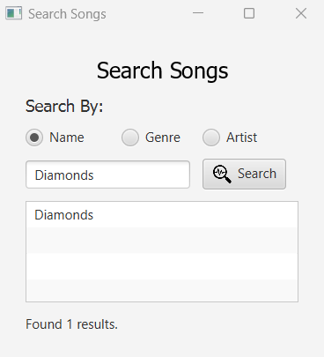

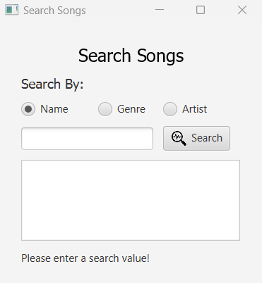
Search Page Features
When you click on search Button, if there is any match with the name that you write in the search textbox
it will show up and at the bottom of the page it will say that (Found n results.).
If app could not find any match it will show (No results found!).
If you don’t type any text inside the search textbox it will say (Please enter a search value!).

Slide 18
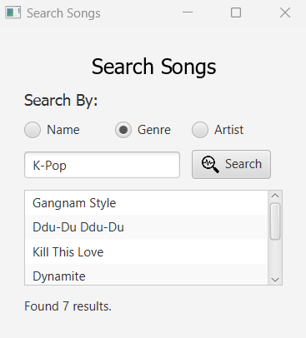

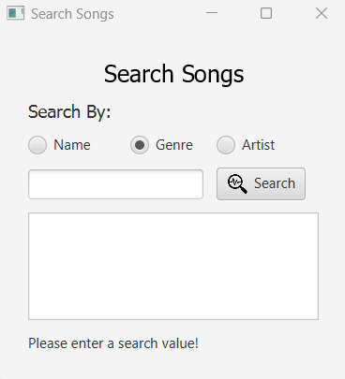
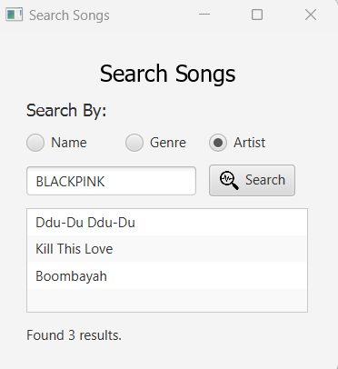

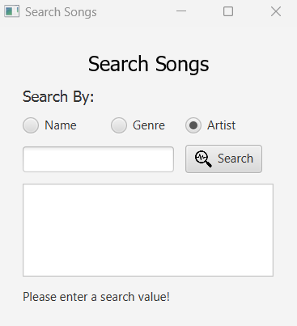

Slide 19
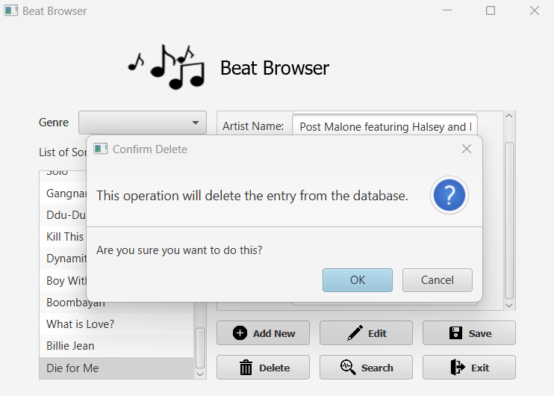
Try To Delete a Song
Showing an Alarm says
(This operation will delete the entry from the database.)
(Are You sure you want to do this?)

Slide 20
public void deleteSong() {
// show confirmation for delete event
Alert alert = new Alert(Alert.AlertType.CONFIRMATION);
alert.setTitle("Confirm Delete");
alert.setHeaderText("This operation will delete the entry from the database.");
alert.setContentText("Are you sure you want to do this?");
Optional<ButtonType> result = alert.showAndWait();
if (result.get() == ButtonType.OK){
String name = songName.getText();
// now get the song object with this info,
// from the songList
SongList songByTitle = songList.findSongsByTitle(name);
if (songByTitle.size() > 0) {
Song song = songByTitle.get(0);
// delete this song from the list
songList.deleteSong(song);
// remove song from observable array
songs.remove(name);
// select the first element in list view
songNames.getSelectionModel().select(0);
// set all the fields to empty
songName.setText("");
artistName.setText("");
albumName.setText("");
releaseDate.setText("");
genreName.setText("");
writers.setText("");
producers.setText("");
awards.setText("");
}
}
}
MainUI.java
Delete | deleteSong
SongList.java
public void deleteSong(Song song) {
songList.remove(song);
}
Notes:
This is a Java method called deleteSong that allows the user to delete a song from the songList.
The method first displays a confirmation alert using the Alert class from the JavaFX library to ask the user to confirm whether they want to delete the selected song. If the user clicks the "OK" button, the method proceeds with the deletion process.
The method then retrieves the name of the currently selected song from a JavaFX Label called songName. It uses the findSongsByTitle method of the SongList class to find the Song object in the songList that matches the selected song title. If a match is found, the Song object is retrieved and deleted from the songList using the deleteSong method of the SongList class.
Next, the method removes the deleted song title from the ObservableList called songs that is used to populate the songNames ListView, and selects the first item in the songNames ListView using the setSelectionModel() method. Finally, the method sets all the fields on the user interface to empty strings, effectively clearing the details of the deleted song from the display.
----------------------------------------------------
This is a method in Java that deletes a Song object from a List of Song objects called "songList". The method takes in a Song object as a parameter, which is the Song object that is to be deleted from the songList.
The method uses the "remove" method of the List class to remove the specified Song object from the songList. If the songList does not contain the specified Song object, then the remove method does nothing.
It is important to note that this method assumes that the Song objects in the songList are unique, meaning that there are no duplicate Song objects in the list. If there are duplicate Song objects in the list, then only the first occurrence of the Song object will be removed.

Slide 21
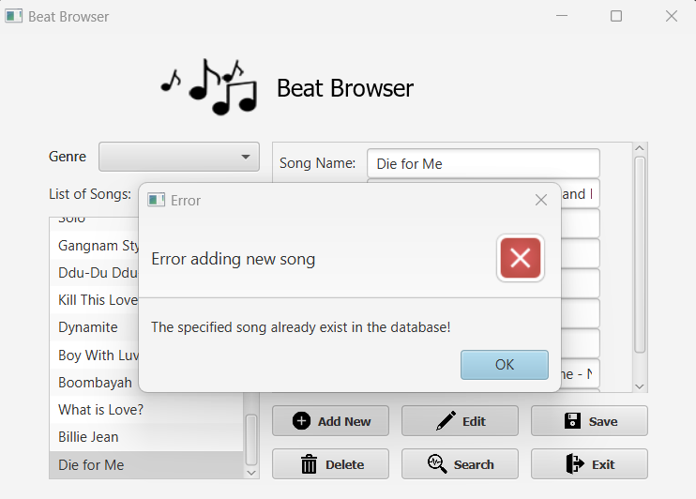
Try adding the same song
Showing an error says
(Error adding new song)
(The specified song already exist in the database!)
if (songsTitle.get(i).getSongArtist().equals(artist) &&
songsTitle.get(i).getSongAlbum().equals(album)) {
Alert alert = new Alert(Alert.AlertType.ERROR);
alert.setTitle("Error");
alert.setHeaderText("Error adding new song");
alert.setContentText("The specified song already exist in the database!");
doesExist = true;
alert.showAndWait();
}
Notes:
The code snippet you provided appears to be a Java if-statement that checks if a song with a specified artist and album already exists in a database. If the song already exists, it will display an error message using JavaFX's Alert class.
To break it down further, the code checks the condition in the if-statement using the ".equals()" method to compare the artist and album of the current song in the loop with the specified artist and album passed in as parameters. If the condition is true, a new instance of Alert class is created with the specified type, title, header text, and content text.
The "doesExist" boolean variable is set to true, indicating that the specified song already exists in the database. Finally, the alert is displayed using the ".showAndWait()" method to show the error message to the user.

Slide 22







The Icons I used for the buttons, I get them from the PowerPoint Icon.
And also I made the Beat Browser Logo in PowerPoint
Add
Edit
Save
LOGO
Delete
Search
Exit

Slide 23
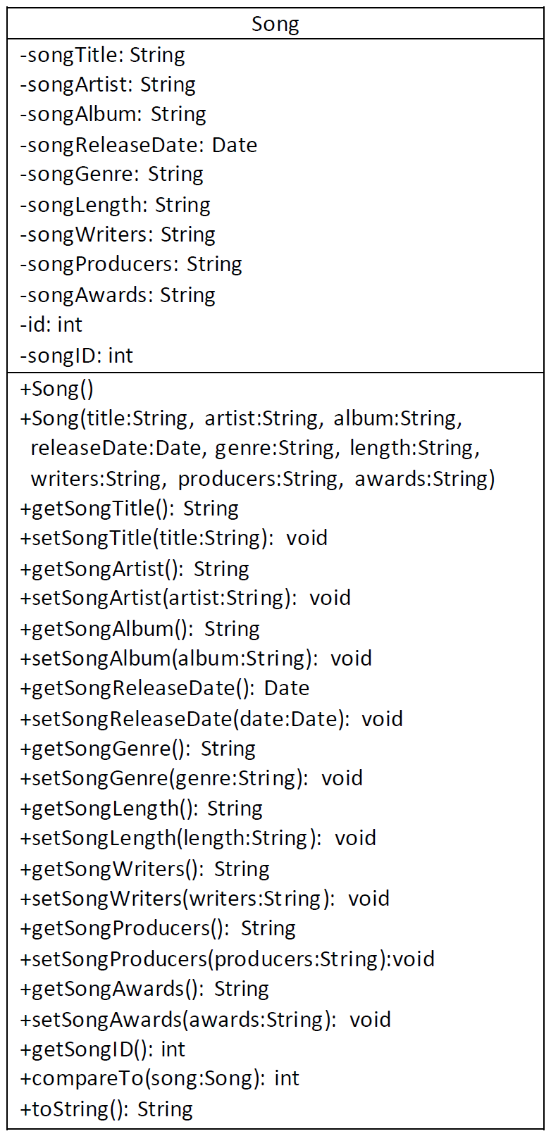
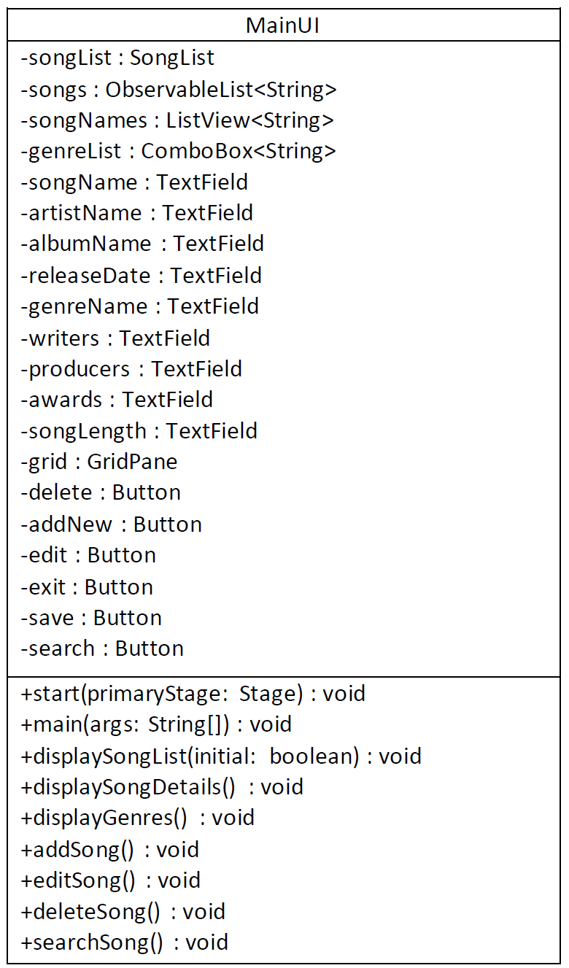
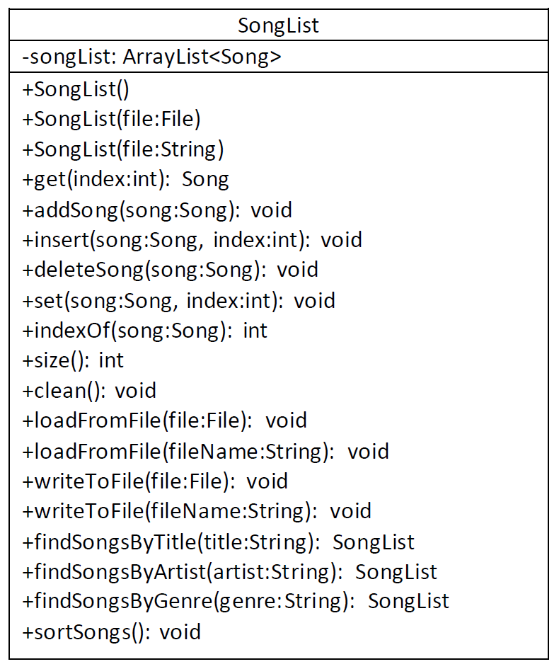
UMLs

Slide 24


UML
*
1
Song
SongList
1
Aggregation
Composition
MainUI
1
Extends
Application

Slide 25


THANK YOU
Amir Hosein Khanmohammadi
Khanmoam@sheridancollege.ca

